Slide 1
iPads at FRA
Using the iPad in the classroom to ensure progress

Slide 2
Thank you for attending
1
Why are we doing this?
Expectations
Information
Collecting the Ipad
2
3
4

Slide 3
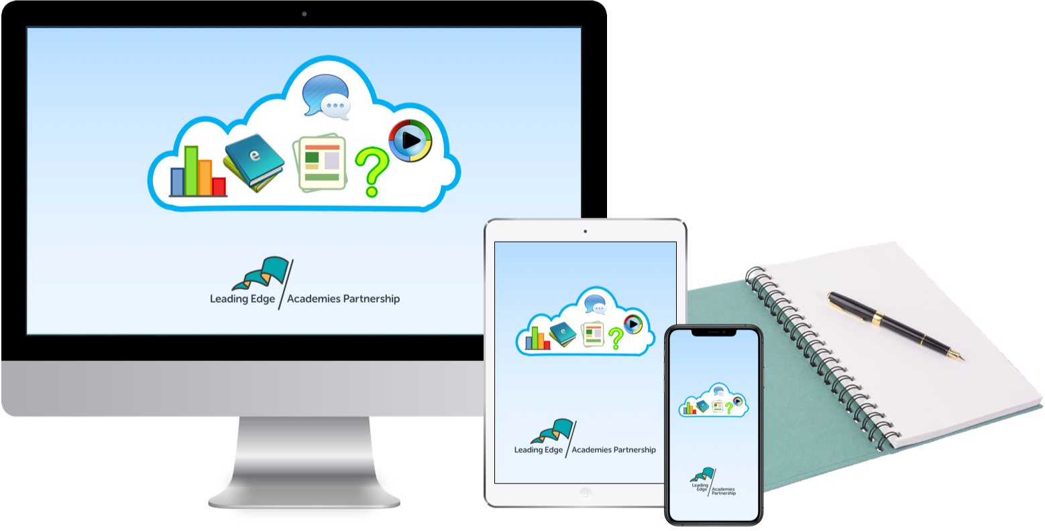
Why are we doing this?

Slide 4
A 21st Century Education system
Students are different
Personalised learning journeys
Scaffolding to meet the needs of students
21st Century skills in preparation for the next stage of education or work
Develop healthy collaboration
Develop confidence
To focus on the learning
The Ipad will not
Replace written work
Will not discourage beautiful work
Will not limit learners

Slide 5
Expectations

Slide 6
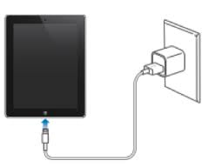
Expectations
iPads must be brought into the Academy each morning fully charged and ready for use in lessons.
Parents and guardians must agree to ensure that the iPad is charged overnight at home.

Slide 7
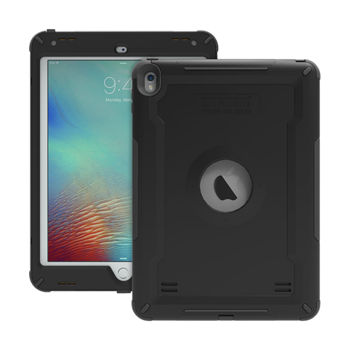
Expectations
iPads must not be taken out of the protective cases.
If there is a problem see Mr Wilkins who will help.

Slide 8
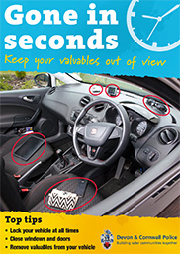
Expectations
iPads must not be left in a public place or in a vehicle as this will increase the chance of theft.
If the iPad is stolen, you must notify the Police and let the Academy have the Police incident number and other reasonable details relating to the loss.

Slide 9
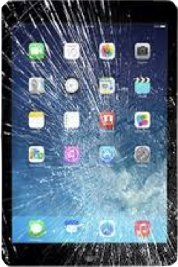
Expectations
If an iPad is damaged lost or stolen there will be a charge of £50 to cover the replacement costs.
This is part of the Acceptable Use Policy (AUP)

Slide 10
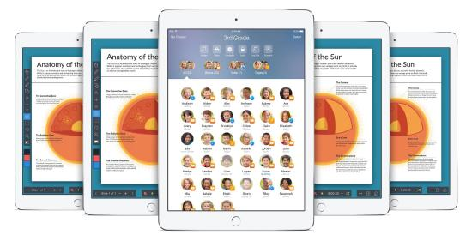
Expectations
During school hours iPads must not be used outside the main building or during break and lunch times without permission from a member of teaching staff.
In the Academy your iPad should be left with your class teacher if you leave the room for the toilet or an errand.
iPads must be placed face down until you have permission to use them.

Slide 11
Information

Slide 12
To ensure we are supporting good mental health and learning behaviours the Academy’s iPads are locked down at night.
For Year 7,8 and 9 they will be locked down at 9pm
For Year 10 and 11 they will be locked down at 10.30pm
This means iPads internet access and camera are suspended until 6am the next morning.
Your sleep is important!

Slide 13
You must always obey the rules about email and social media that are set out in the AUP.
The Academy monitors the use of emails, photos and internet access on your iPad to ensure compliance with this policy.
As a result there is no explicit right of privacy when using your iPad. Treat it like a school book – it will be looked at.
Your iPad’s internet is filtered in school and at home.
Everything you search or ‘Google’ is recorded and monitored for your safety.

Slide 14
iPads are to be returned to the Academy:
Year 7 – 10 July 2020
Year 11 – June 2020
If you are leaving the Academy.
If there is a consistent abuse of the AUP.

Slide 15
Collecting your Ipad

